Slide 1
BERT-NLP
Machine learning final presentation
M10807429 李旻哲

Slide 2
大綱
Introduction
Structure-architecture of BERT
Preprocessing Data
Fine-tuning BERT
Fine-tuning BERT-parameter setting
Fine-tuning BERT-result analysis

Slide 3
Introduction
contextualized word embeddings
transformers library by folks at Hugging Face
fine-tune BERT on Stanford Sentiment Treebank dataset
Notes:
The research picture was collected in the Xindiyuan elevated strawberries picking garden in Liuhe District, Nanjing City. The collected images through bilateral filtering algorithm to filter
研究圖片收集在新帝園高架草莓在六合區，南京市採摘園。通過雙邊濾波 算法所收集的圖像進行濾波

Slide 4
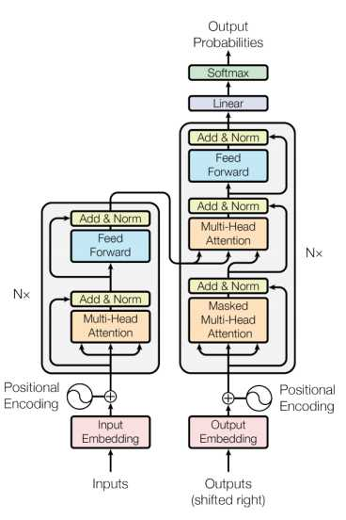
Structure-architecture
of
BERT
Source: Attention is all you need. Vaswani et al. (2017)

Slide 5
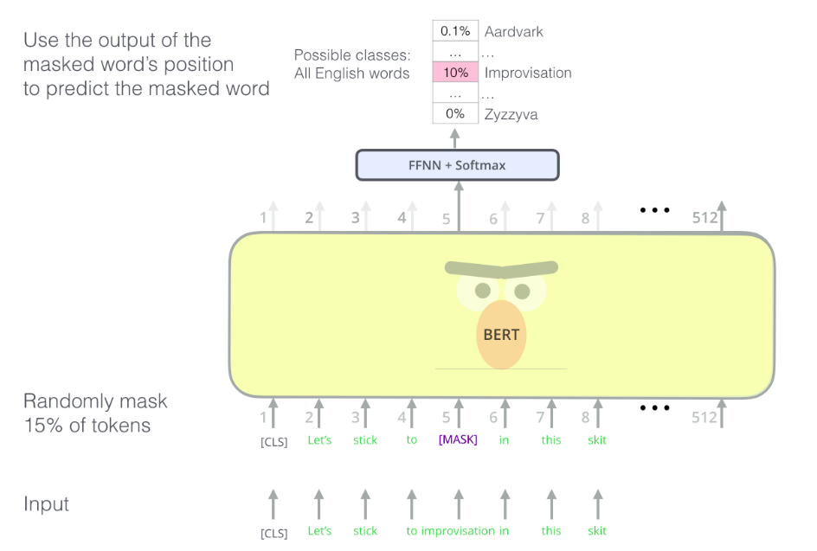
Masked Language Model
Source: Jay Alammar’s Blog
Notes:
BERT的聰明的語言建模任務掩蓋了輸入中15％的單詞，並要求模型預測丟失的單詞。
找到正確的任務來訓練Transformer編碼器堆棧是BERT解決的一個複雜障礙，它採用了早期文獻中的“掩蓋語言模型”概念（在這裡稱為Cloze任務）。
除了掩蓋15％的輸入外，BERT還進行了一些混合，以改進模型稍後進行微調的方式。有時，它會用另一個單詞隨機替換一個單詞，並要求模型預測該位置的正確單詞。

Slide 6
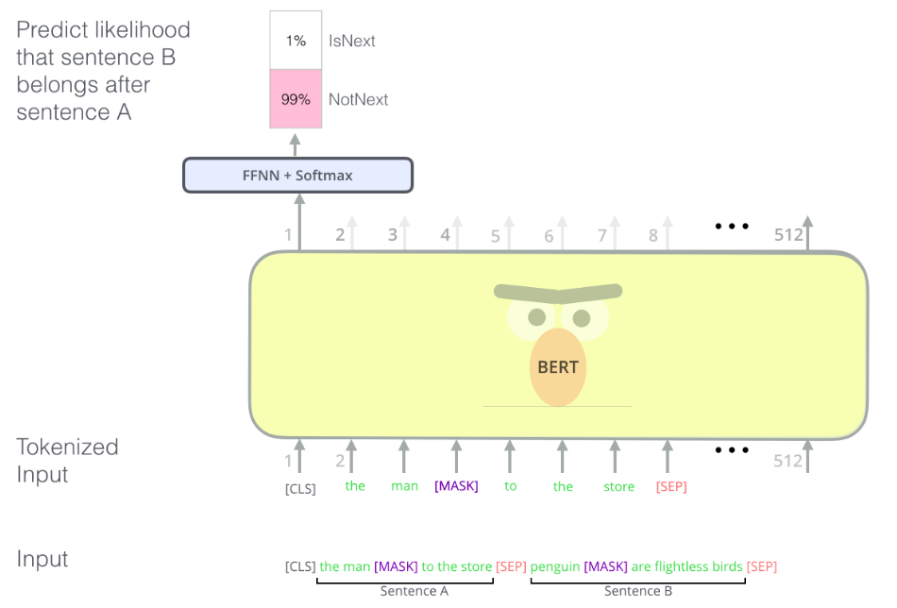
Next Sentence Prediction
Source: Jay Alammar’s Blog
Notes:
如果您回顧一下OpenAI轉換器為處理不同任務而進行的輸入轉換，您會注意到某些任務要求模型對兩個句子說一些聰明的東西（例如，它們僅僅是彼此的釋義版本？給定維基百科條目）作為輸入，以及關於該條目的問題作為另一輸入，我們可以回答該問題嗎？）。
為了使BERT更好地處理多個句子之間的關係，預訓練過程包括一項附加任務：給定兩個句子（A和B），B可能是跟在A後面的句子嗎？
對第二個任務BERT進行預訓練的是兩句分類任務。由於BERT實際上使用WordPieces作為令牌而不是單詞，因此該圖形中的令牌化過於簡單---因此某些單詞被分解為較小的塊。

Slide 7
Preprocessing Data
Tokenize the sequence
Add [CLS] and [SEP] tokens
Padding the input
Maintain a list of segment tokens
Obtaining indices of the tokens in BERT's vocabulary

Slide 8



Fine-tuning BERT
Dataset class
Model
Training

Slide 9
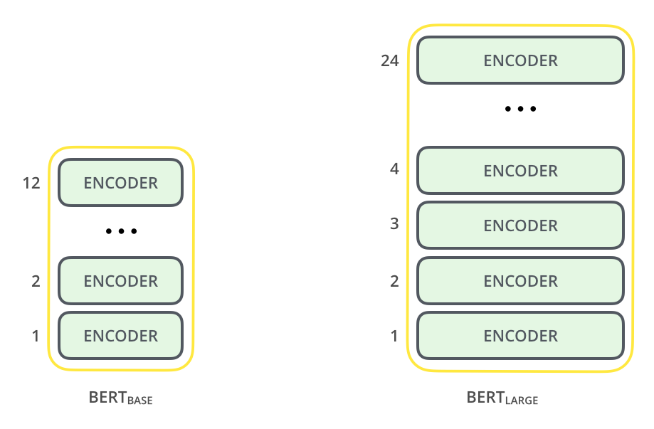
Model Complexity
12 and 24 layers
768 and 1024 neruals
110M and 340M data
https://www.google.com/url?sa=i&source=images&cd=&cad=rja&uact=8&ved=2ahUKEwiPnN3Dq9jmAhVcL6YKHe3gD18Qjhx6BAgBEAI&url=http%3A%2F%2Fjalammar.github.io%2Fillustrated-bert%2F&psig=AOvVaw3RaaAnayfojUDSXrbZ6FVm&ust=1577622358903543

Slide 10
Understanding our data
t-SNE 數據降維與可視化
Tried to visualize the CLS Token embeddings after fine-tuning on SST-2 using t-SNE, but no clear clustered visualizations of positive and negative sentences !

Slide 11
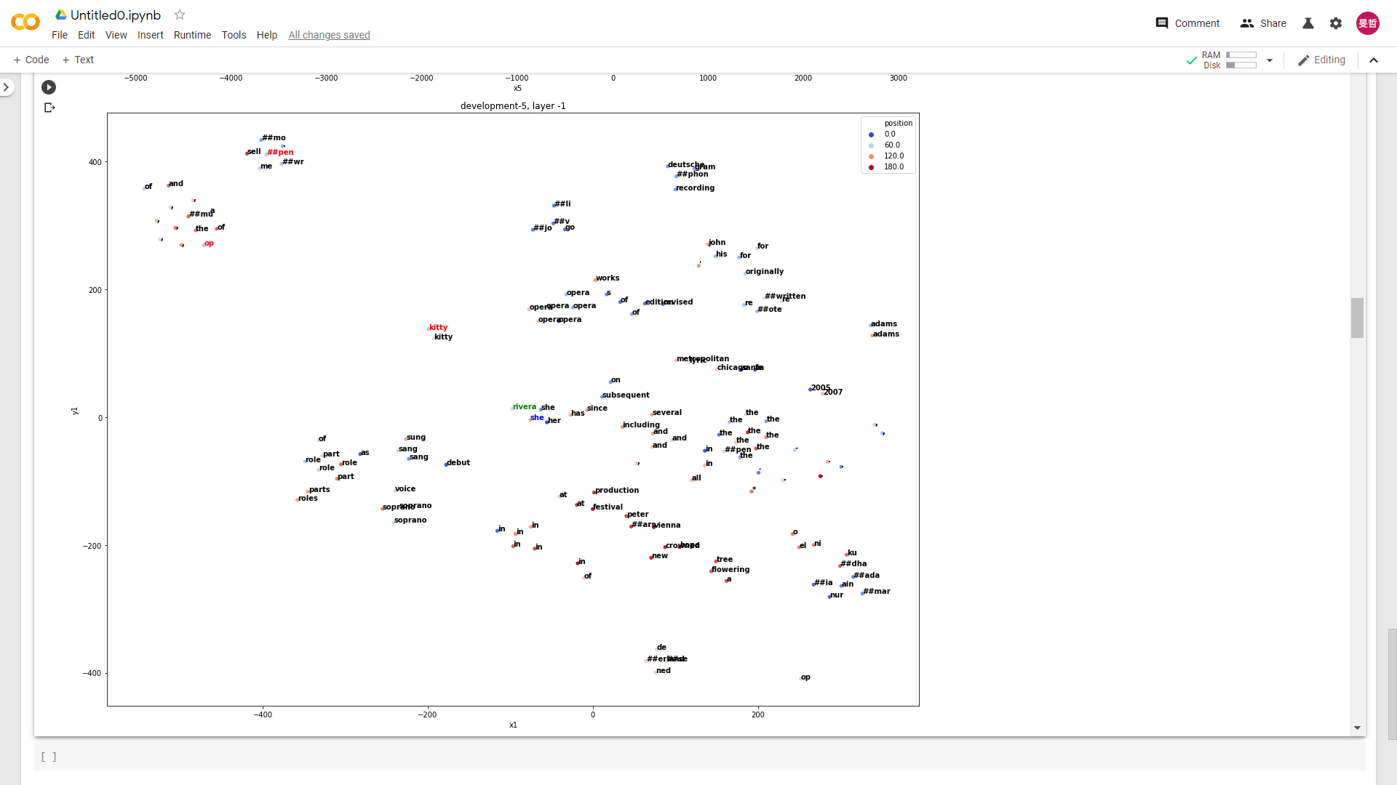
Understanding our data

Slide 12
Understanding our data

Slide 13
Model Effectiveness(binary classification)
Accuracy(average in five times train and test)
Batch size :32
Learning rate:1e-5
Epoch:5
Pre-train with bert-base-uncased(110M)
Pre-train with bert-large-uncased(340M)
criterion =nn.BCEWithLogitsLoss
opti = optim.Adam(net.parameters())

Slide 14
Model Effectiveness(fine-grained)
Accuracy(average in five times train and test)
Batch size :50
Learning rate:1e-5
Epoch:5
Pre-train with bert-base-uncased(110M)
Loss fun = torch.nn.CrossEntropyLoss()
optimizer = torch.optim.Adam(model.parameters(), lr=1e-5)

Slide 15
Creative ideas & How much domain knowledge is involved?
Transformer helps me to better understand how bert works
Recurrent neural network

Slide 16
Future work
build a costumer feedback analysis system , which can help online trailer organize all the message which is more efficient and less cost on customer service.

